Slide 1

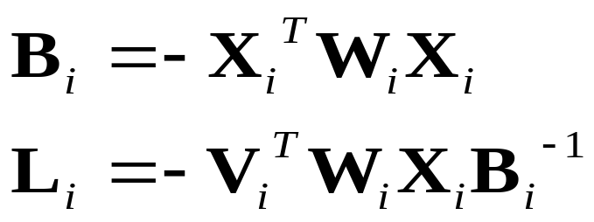
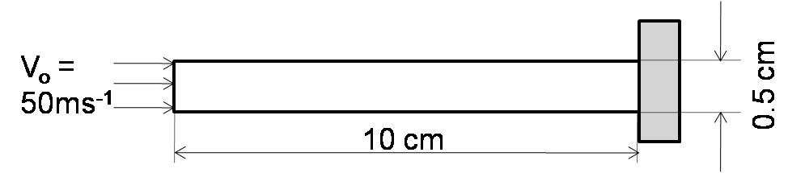
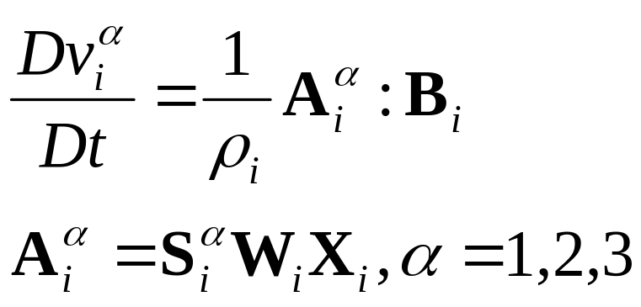
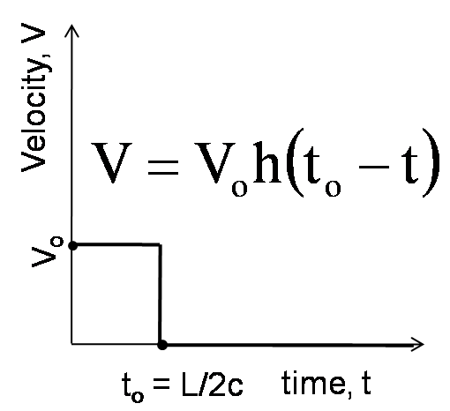
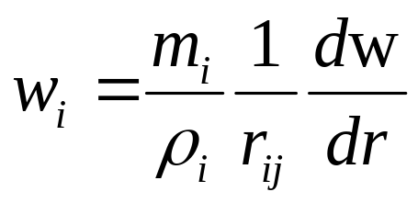
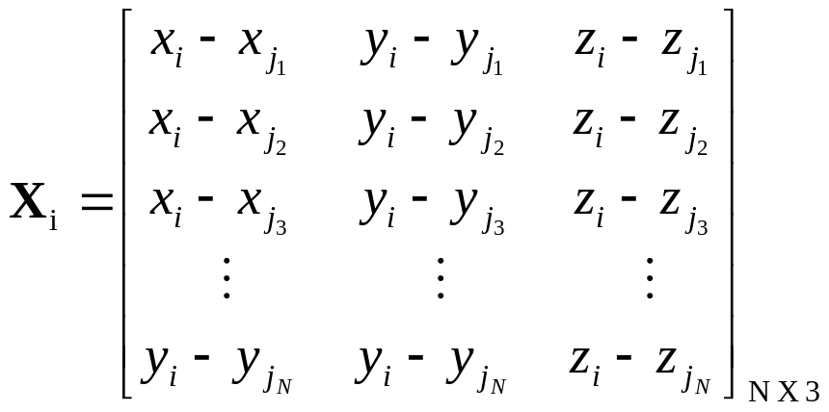
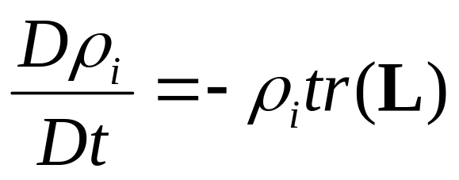
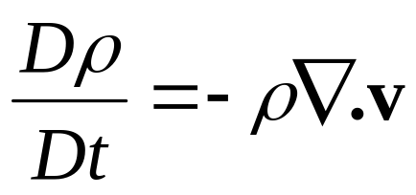
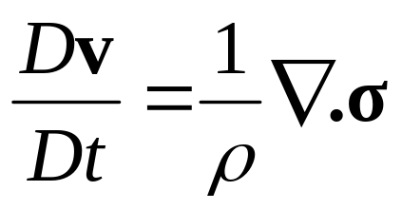
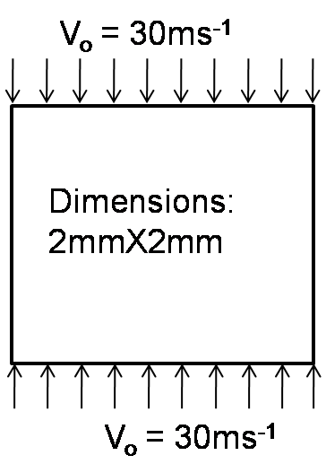
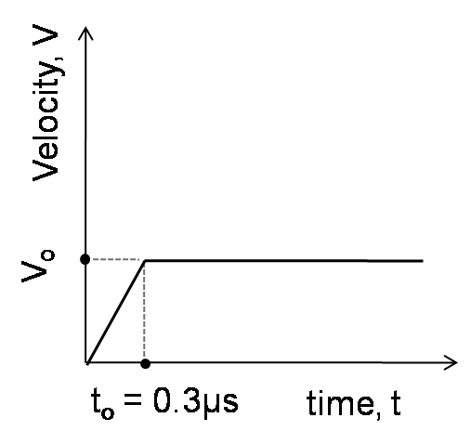
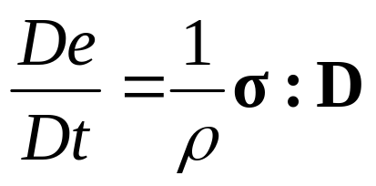
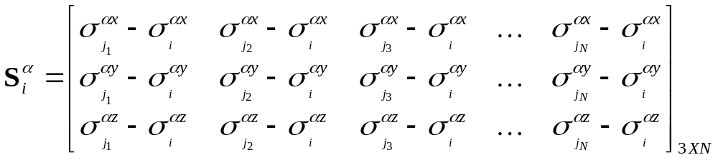
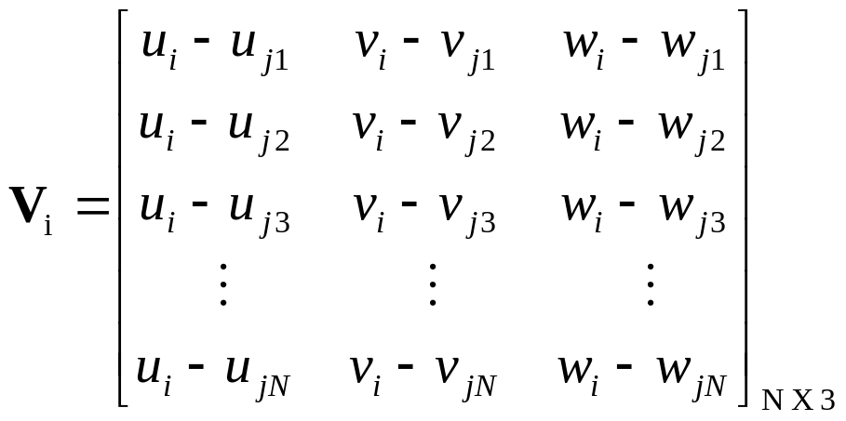
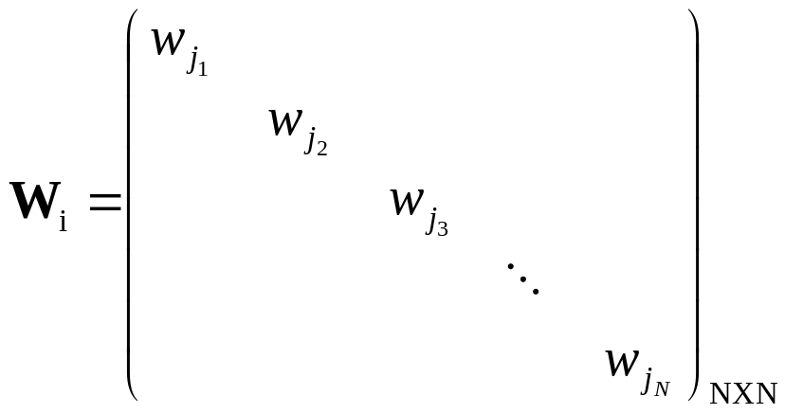
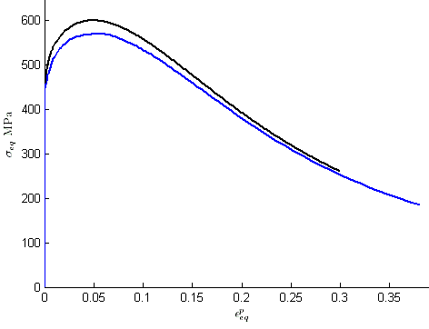
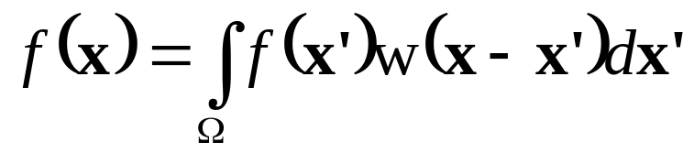

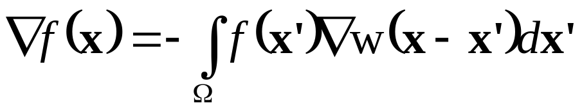
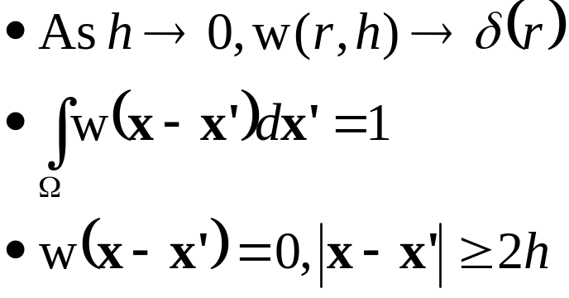
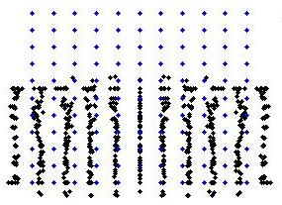
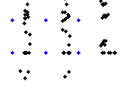
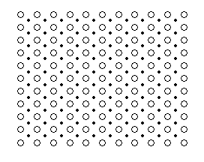
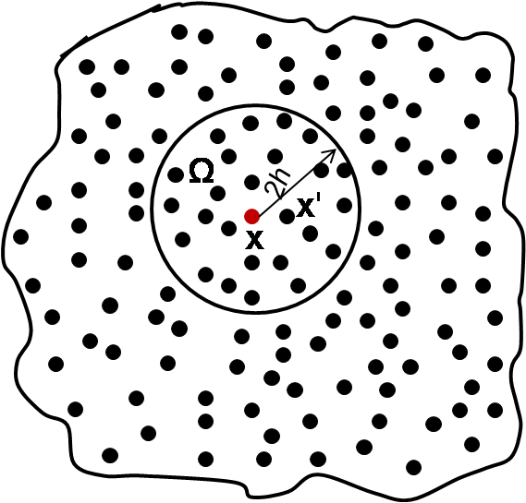
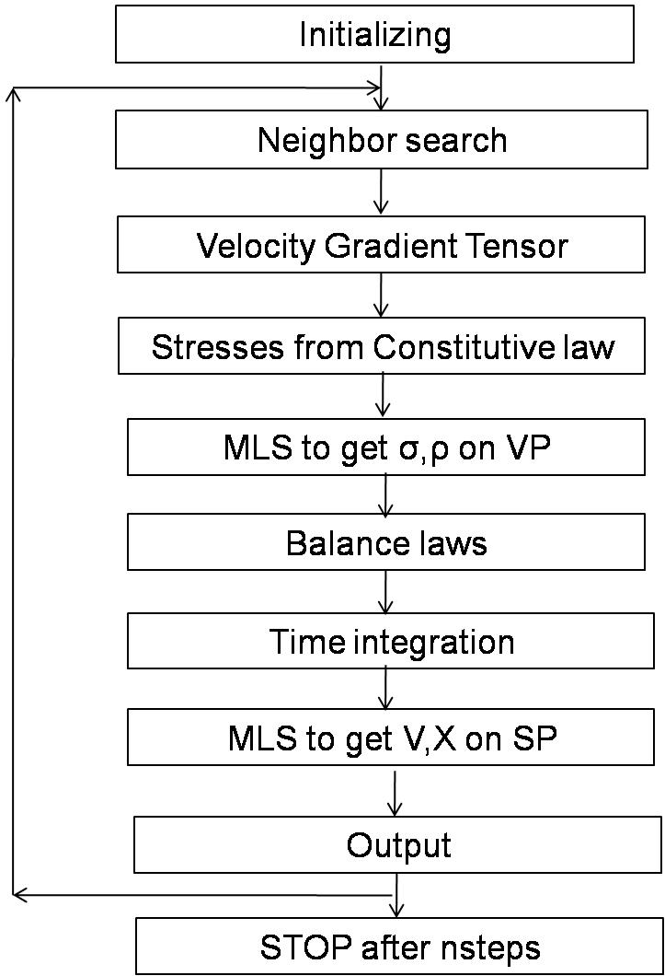
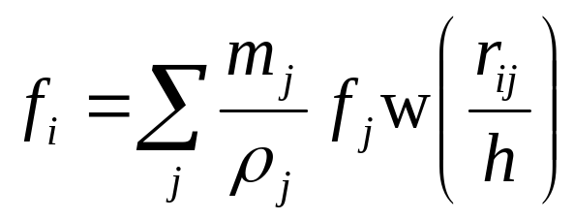
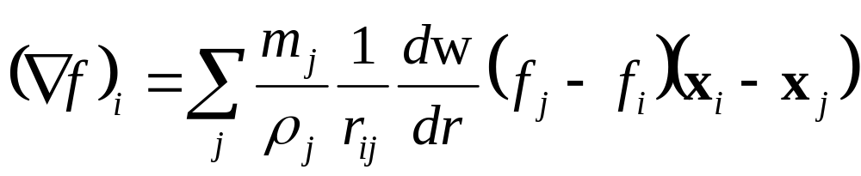
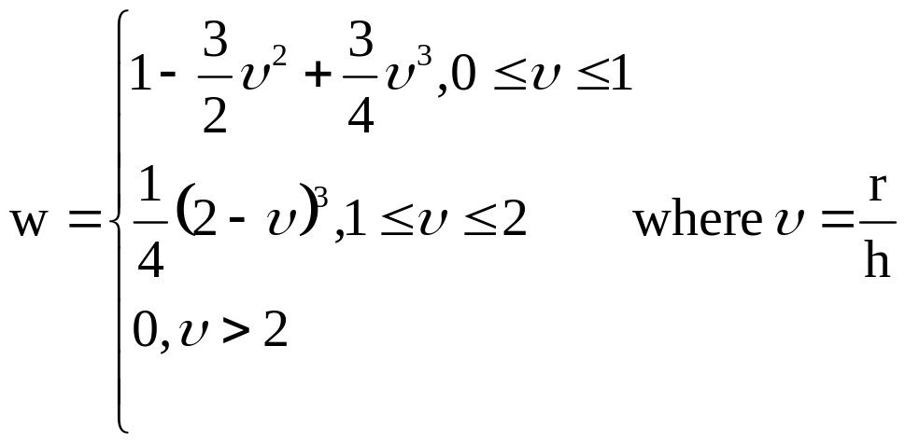
POSTER TITLE – Line 1
POSTER TITLE – Line 2
Student Name & Adviser Name
Department of Mechanical Engineering, IIT Kanpur
Introduction:
Equations in Matrix form:
Results & Discussion:
High Velocity Impact
Strain rates
Meshless
1. Elastic Bar Impact:
Neighbors of particle, i
Problem domain for bar impact problem
Governing Equations:
Applied Velocity Variation with time
Balance of mass:
2. Shear band:
Balance of linear momentum
without body forces:
Balance of energy for adiabatic
deformation:
Methodology:
Problem domain for
Shear band problem
Applied Velocity
Variation with time
Equivalent plastic strain contour
where L is the velocity gradient tensor, D is the strain rate (Johnson, & Beissel 1996; Randles and Libersky 1996 .
Hardening relation expression
For a particle on shear band
Integral Representation of a function
Tension Instability:
Integral representation (kernel representation) of a function and its derivative, based on the dirac delta definition:
Condition for tension instability from Swegle’s stability analysis (Swegle 1995):
Stress point approach: (Dyka and Ingel, 1995; Dyka et.al, 1997; Randles and Libersky, 2000)
Stress points (SP) – stresses , densities, internal energies.
Velocity points (VP) – velocities and accelerations.
Moving Least Squares – MLS for velocities on SP; stresses, densities, internal energies on VP
Equivalent Stress – plastic Strain Curve
where w, the smoothing function defined over the domain Ω, the size of which is represented by the smoothing length
Conclusions:
Figure showing the support domain
Instability caused due to spurious accelerations
SPH Stress point Approach
Particle approximation of kernel representation:
References:
Flowchart showing algorithm
for SPH with stress points
and velocity points
Lucy L., Astron. J. 82 (1977) 1013.
Swegle et.al, Journal of computational physics, 116, (1995)123
Randles & Libersky, Comput.Methods Appl. Mech. Engrg. 139 (1996) 375.
Dyka et.al, Int. J. Numer. Meth. Engng, 40, (1997) 2325
Acknowledgement:

